Slide 1
Skill-Based Candidate Shortlisting
By Srijan Suresh Kumar Suman (12315412)

Slide 2
Organization Details
Name of the Organization: Lovely Professional University (LPU)
Department of Computer Science and Engineering Phagwara, Punjab – 144411
Project Title: Skill-Based Candidate Shortlisting
Course Name: FUNDAMENTALS OF DATA STRUCTURES USING C++(PETV50)
Submitted By:
Name: Srijan Suresh Kumar Suman
Registration No.: 12315412
Program: B.Tech Computer Science and Engineering
Submitted To:
Faculty Name: 27342:Dr. Nishant Agnihotri, 27947:Puneet Kumar
Organization: Lovely Professional University

Slide 3
Course Details
Course Name: FUNDAMENTALS OF DATA STRUCTURES USING C++
Course Code: PETV50
Instructor: 27342:Dr. Nishant Agnihotri, 27947:Puneet Kumar
Session: 2025 - 26
Course Objectives:
To understand fundamental data structures such as arrays, linked lists, stacks, queues, trees, and graphs.
To learn searching and sorting algorithms and analyze their complexities.
To apply DSA concepts for solving real-world computational problems using C++.
To develop efficient and structured programs with file handling and data manipulation techniques.

Slide 4
Data Structures And Algorithms
DSA | Description | Example Code (C++) | Real-Life Usage
Array | Stores data in contiguous memory, allowing fast access via indices. | cpp int arr[]={10,20,30}; cout<<arr[1]; | Used in storing student marks, images, or sensor data.
Linked List | Dynamic collection of nodes connected using pointers. | cpp struct Node{int data; Node* next;}; | Used in playlists, undo-redo operations, and memory management.
Stack | Follows LIFO (Last In First Out) order. | cpp stack<int> s; s.push(10); s.pop(); | Used in recursion, expression evaluation, and backtracking.
Queue | Follows FIFO (First In First Out) order. | cpp queue<int> q; q.push(5); q.pop(); | Used in printer queues, call centers, and task scheduling.
Tree | Hierarchical structure of connected nodes. | cpp struct Node{int data; Node* left; Node* right;}; | Used in file systems, databases (B-trees), and XML parsing.
Graph | Represents relationships between objects as nodes and edges. | cpp vector<int> g[3]; g[0].push_back(1); | Used in social media, Google Maps, and networking.
Hash Table | Stores key-value pairs using hashing for quick access. | cpp unordered_map<string,int> age={{"Tom",25}}; | Used in password storage, caching, and indexing.
Heap | Complete binary tree used for priority-based operations. | cpp priority_queue<int> pq; pq.push(10); | Used in CPU scheduling, heapsort, and priority queues.
Set & Map | Store unique items or key-value pairs for quick retrieval. | cpp set<int>s={1,2}; map<string,int>m={{"A",10}}; | Used in unique ID storage, frequency counting, and lookups.

Slide 5
Skill-Based Candidate Shortlisting
Workflow of Code:
Input number of candidates and details.
Store all candidates in list and map.
Ask for minimum experience and score.
Shortlist candidates matching criteria.
Sort shortlisted list by score descending.
Display shortlisted candidates.
Save shortlisted candidates to CSV.
Read CSV back and display.
Search any candidate by name quickly using the map.

Slide 6
Data Structure | Purpose
struct Candidate | Holds candidate info (name, skills, experience, score)
list<Candidate> | Stores all candidates in insertion order (linked list)
map<string, Candidate*> | Quick lookup by candidate name (O(log n) search)
stringstream | Parses CSV lines for reading/writing
string | Stores names, skills, and text data
ifstream /ofstream | File Handling

Slide 7
Input Candidate Data
Storing Data
Matching/Filtering
Sorting
Shortlisting Candidates

Slide 8
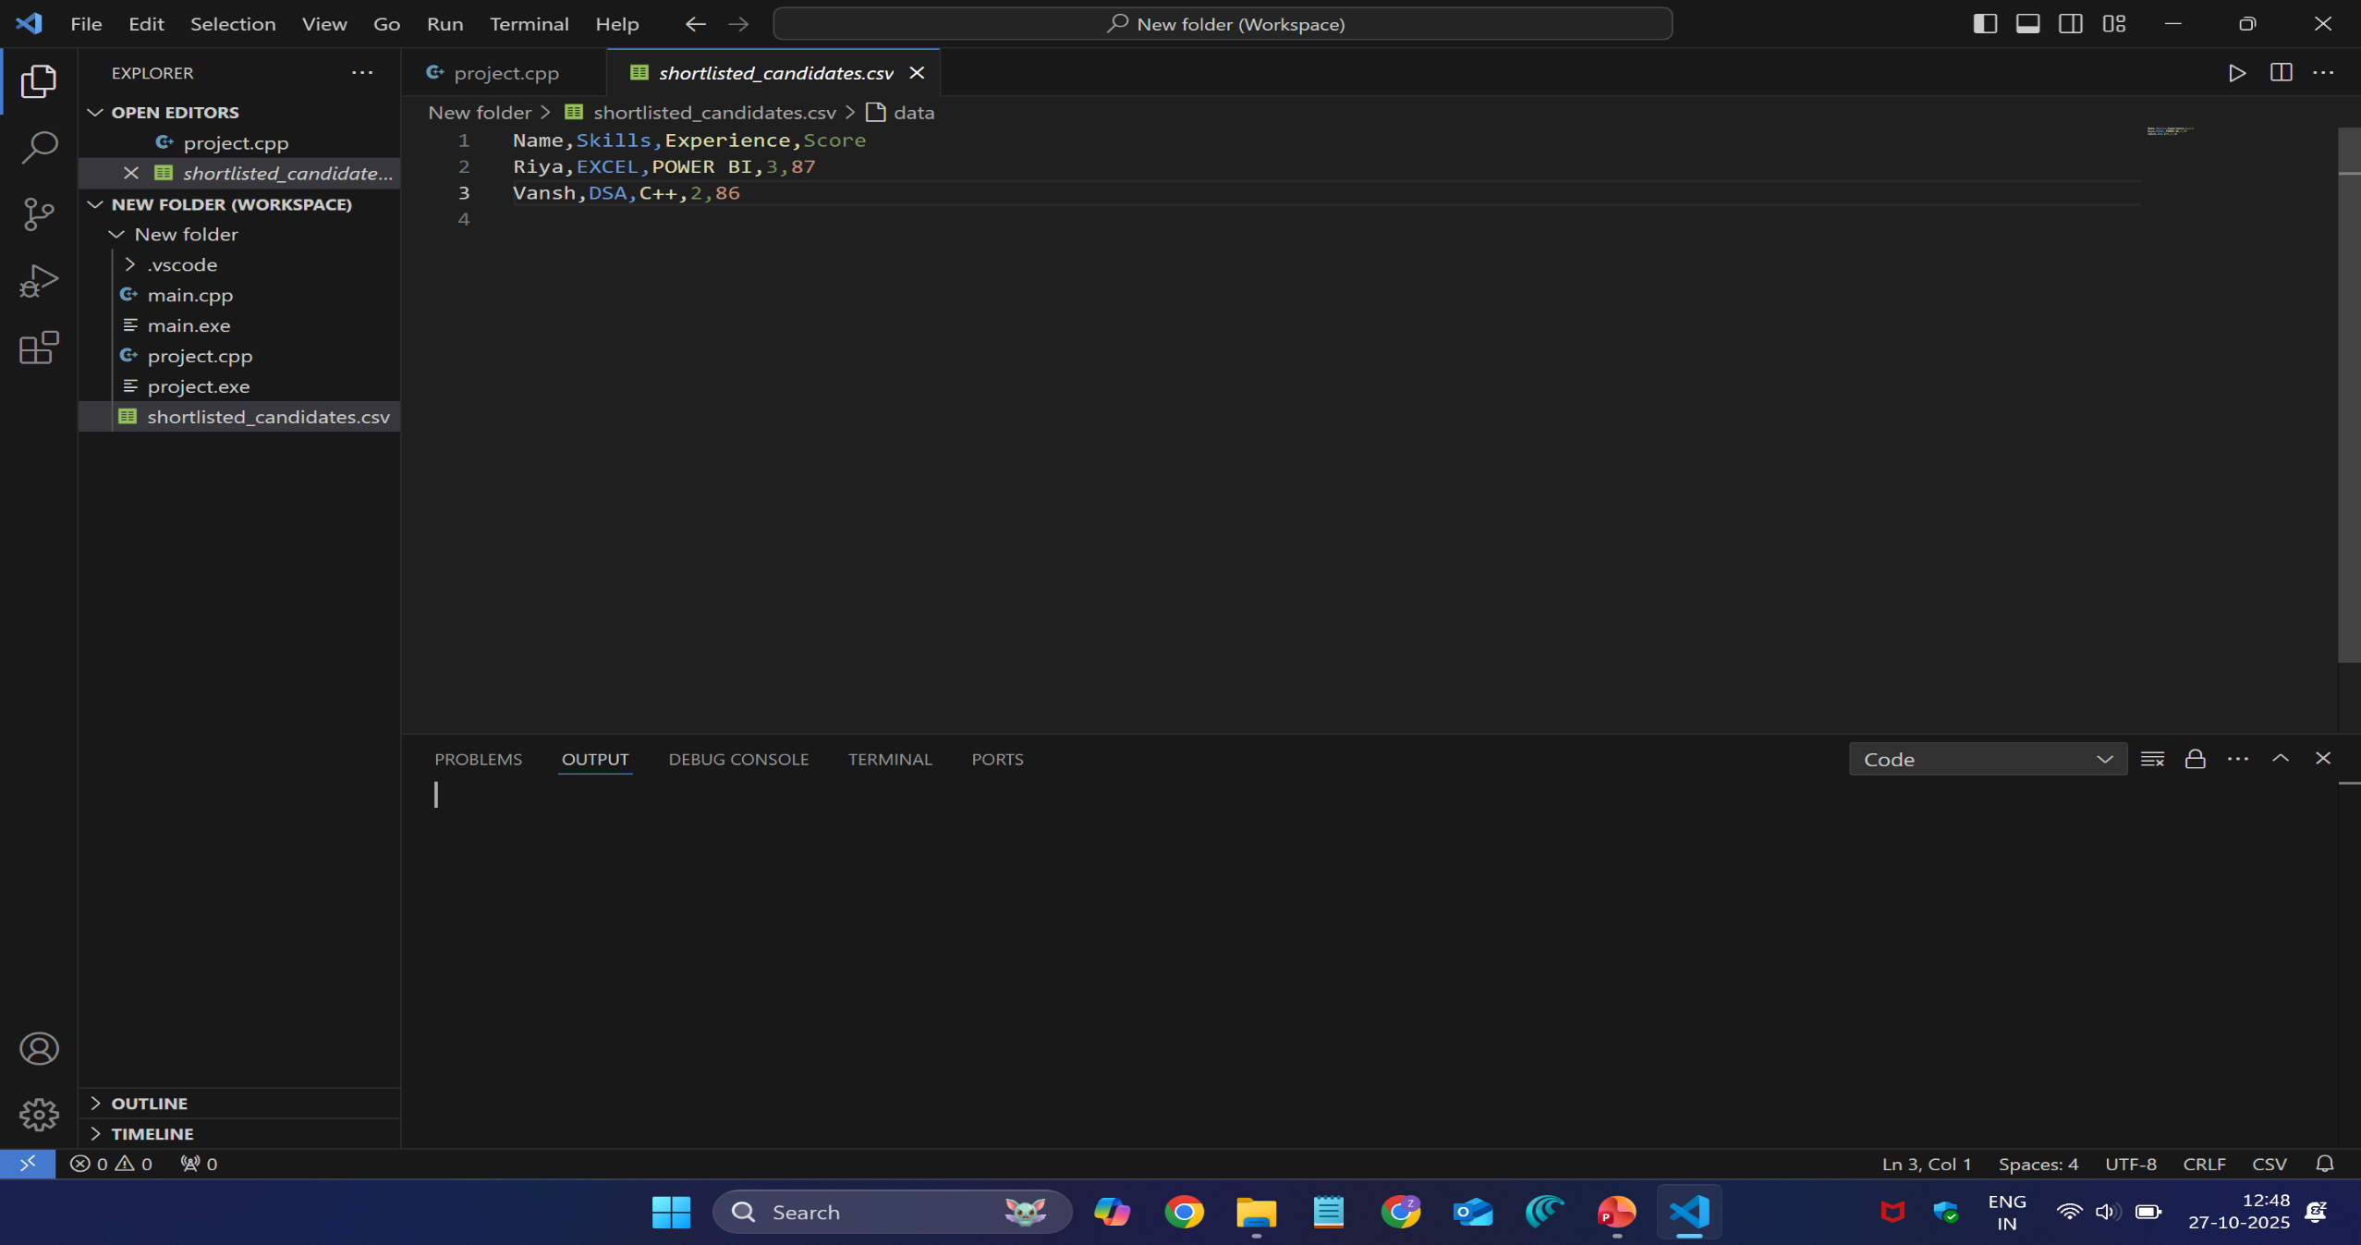
Output

Slide 9
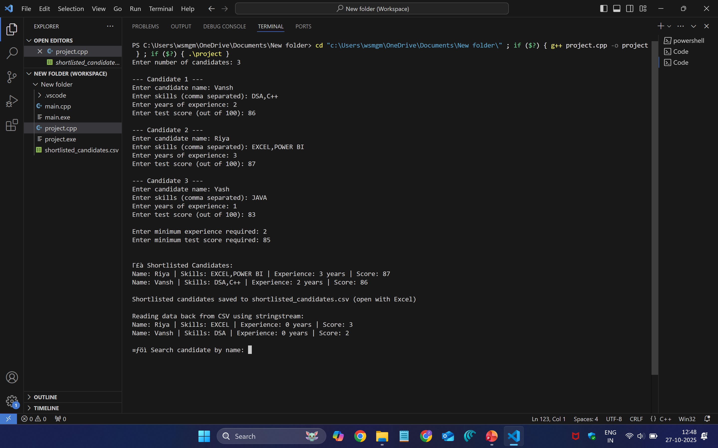

Slide 10
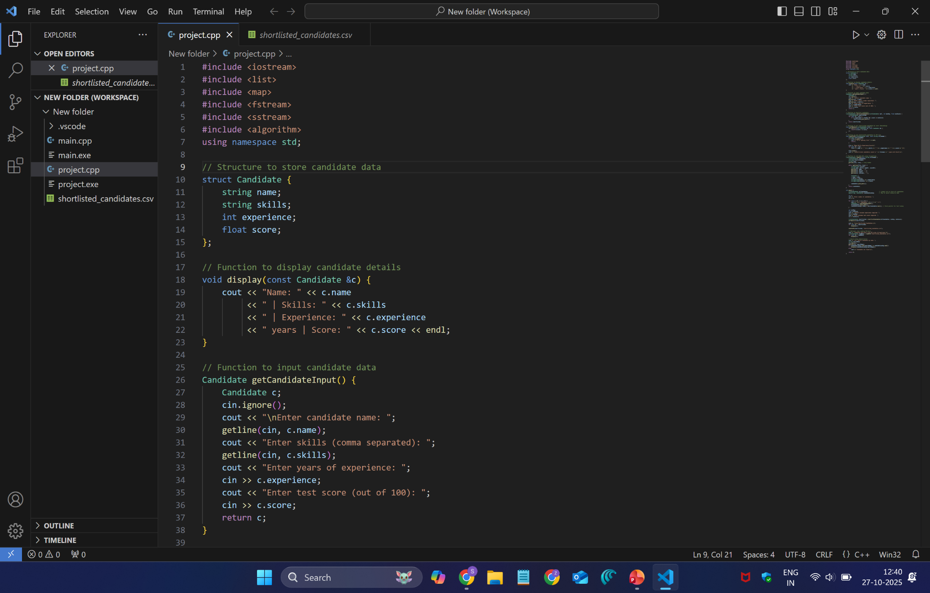
Source Code

Slide 11
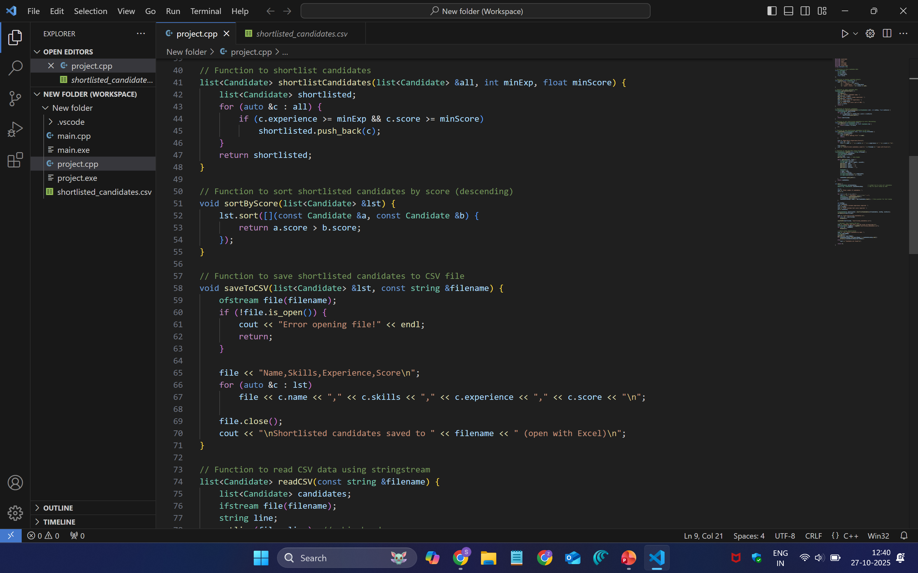

Slide 12
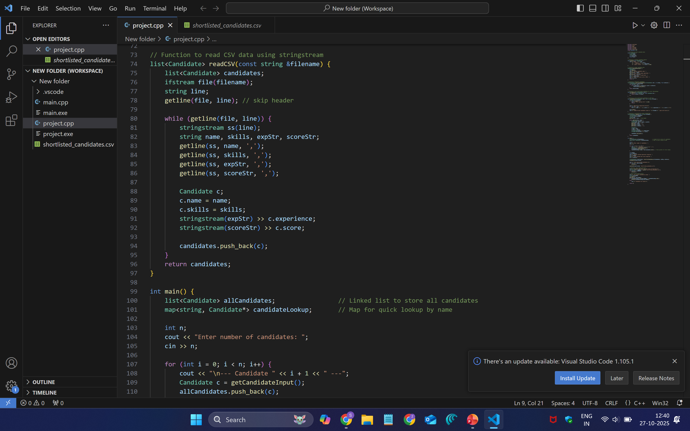

Slide 13
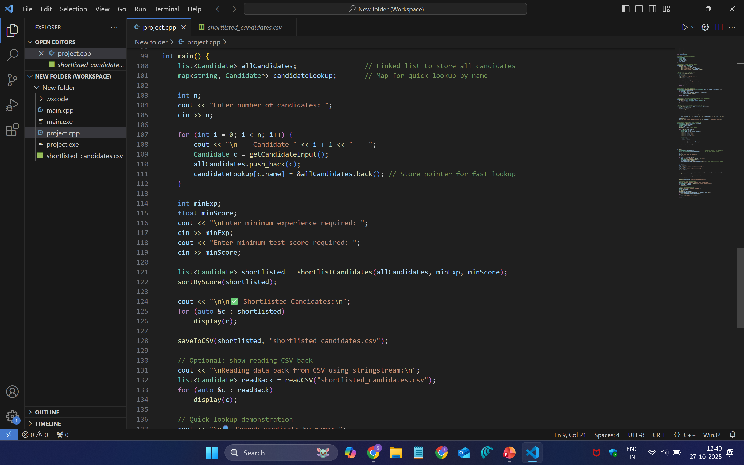

Slide 14
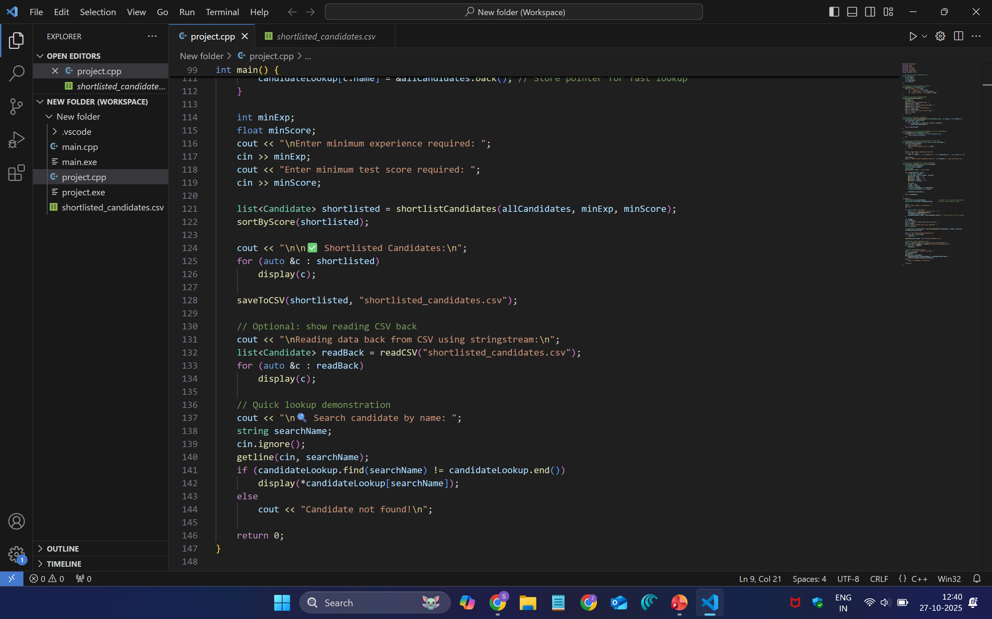

Slide 15
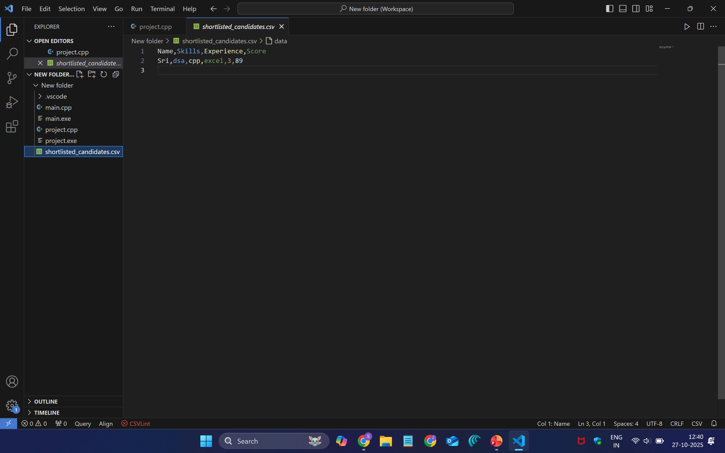

Slide 16
Conclusion
The Skill-Based Candidate Shortlisting successfully demonstrates how data structures like linked lists and maps can be used to efficiently manage and retrieve candidate information.
By using a linked list (std::list), the project maintains all candidate records in insertion order and supports easy insertion and traversal. The map (std::map) provides quick lookup of candidates by name, enabling fast searching without scanning the entire list.
The program also implements filtering, sorting, and file handling features:
Candidates are shortlisted based on minimum experience and test score.
The shortlisted candidates are sorted in descending order of score using the Merge Sort algorithm (through list::sort() in C++).
Data is stored and retrieved from a CSV file using file streams and string streams, demonstrating practical use of input/output handling in C++.
Overall, this project provides an efficient and organized approach to candidate selection and data management, showcasing real-world use of DSA concepts such as maps, linked lists, sorting, and file handling in C++.

Slide 17
Bibliography
https://www.geeksforgeeks.org/cpp/map-associative-containers-the-c-standard-template-library-stl/
https://www.google.com/
https://www.geeksforgeeks.org/dsa/dsa-tutorial-learn-data-structures-and-algorithms/
https://www.w3schools.com/cpp/

